Slide 1
Employee Management System
By Ankit Singh
EmpID :- 206635

Slide 2
Outline
Introduction
Functionalities
Database Structure
Code Snippets & Outputs
Tech Stack
Conclusion

Slide 3
INTRODUCTION
This is a console based application designed to make managing employee records both easy and efficient.
For administrators, it simplifies the process of handling employee data, manage all employee data, while employees can update their personal details and view their profiles.

Slide 4


Tech Stack
Language : Python
Database: MySQL
Schema : Employee(Id, Name, Email_Id, Phone_no ,
Address, Post, Salary)

Slide 5
Functionalities
Admin Login/Signup
Add Employee
Display Employee Record
Update Employee Record
Promote Employee Record
Remove Employee Record
Search Employee Record
Exit

Slide 6
DATABASE STRUCTURE
Tables used:
Employee(Id, Name, Email_Id, Phone_no , Address, Post, Salary)

Slide 7
CODE WALKTHROUGH
Connect to MySQL Database
Admin Authentication (Login/Signup)
CRUD (Create, Read, Update, Delete) Operations on Employee Data

Slide 8
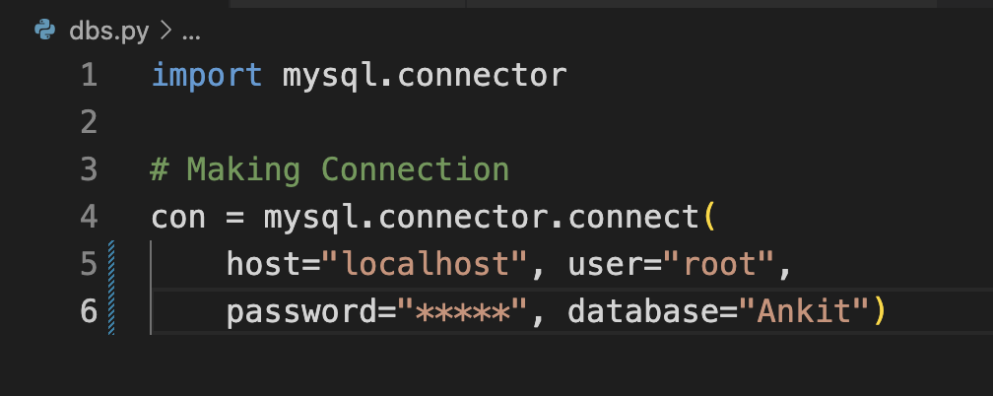
CONNECT TO
DATABASE (MYSQL)

Slide 9
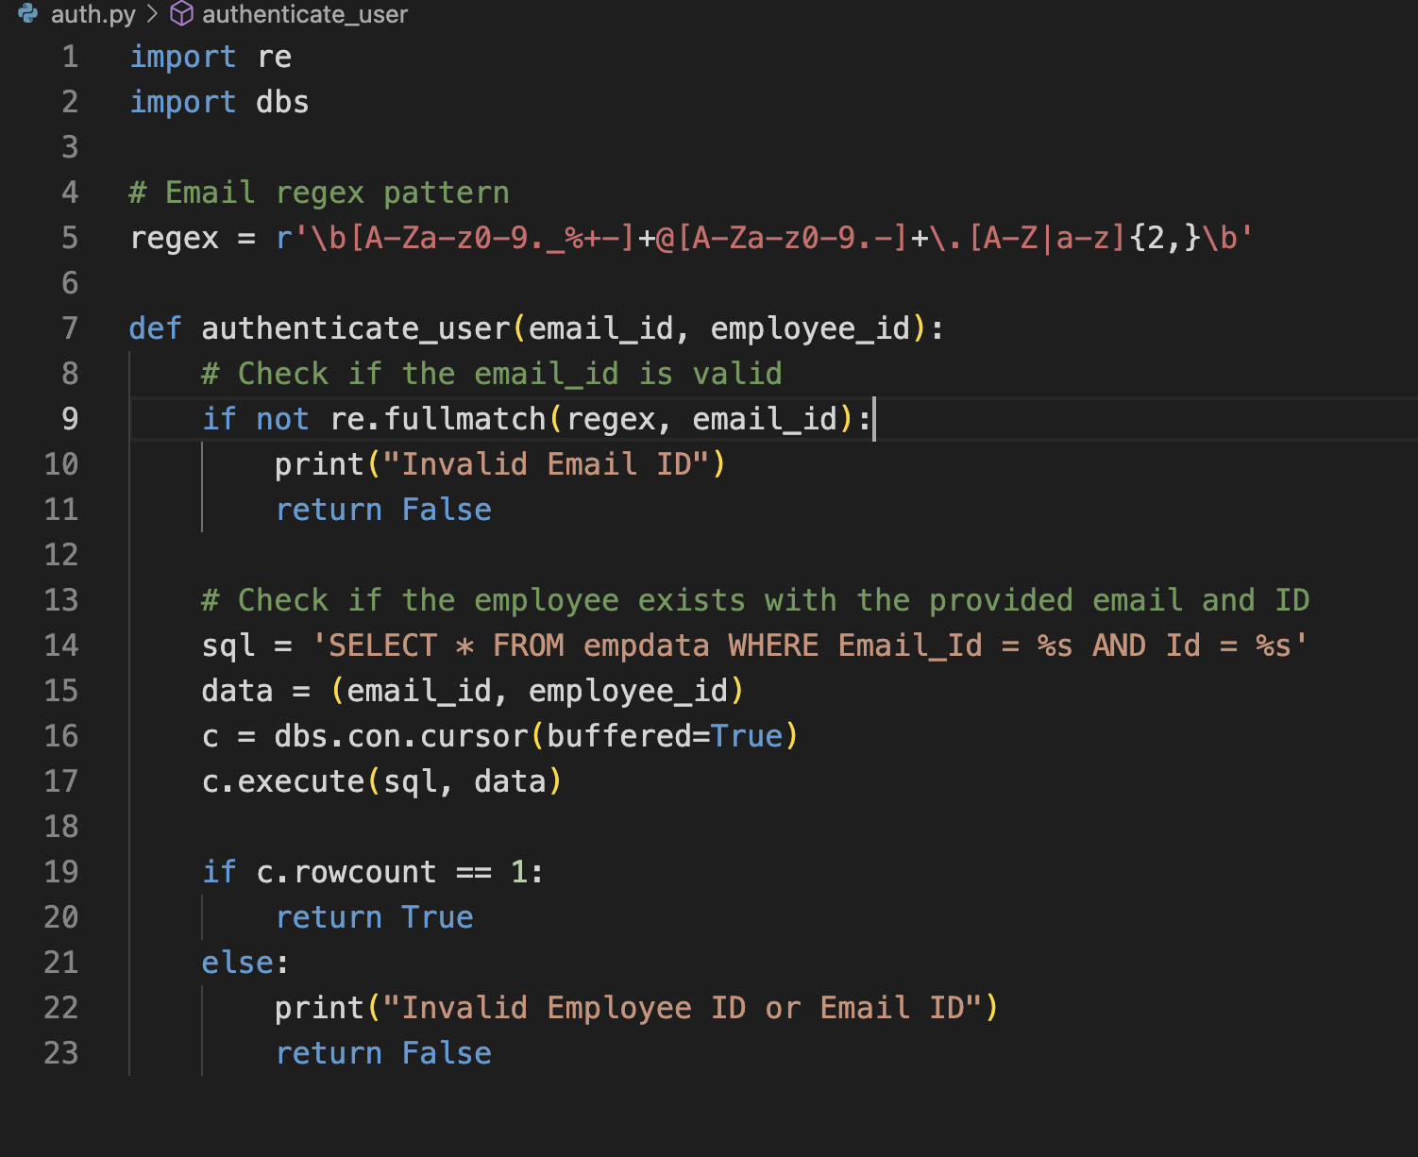
LOGIN VERIFICATION

Slide 10
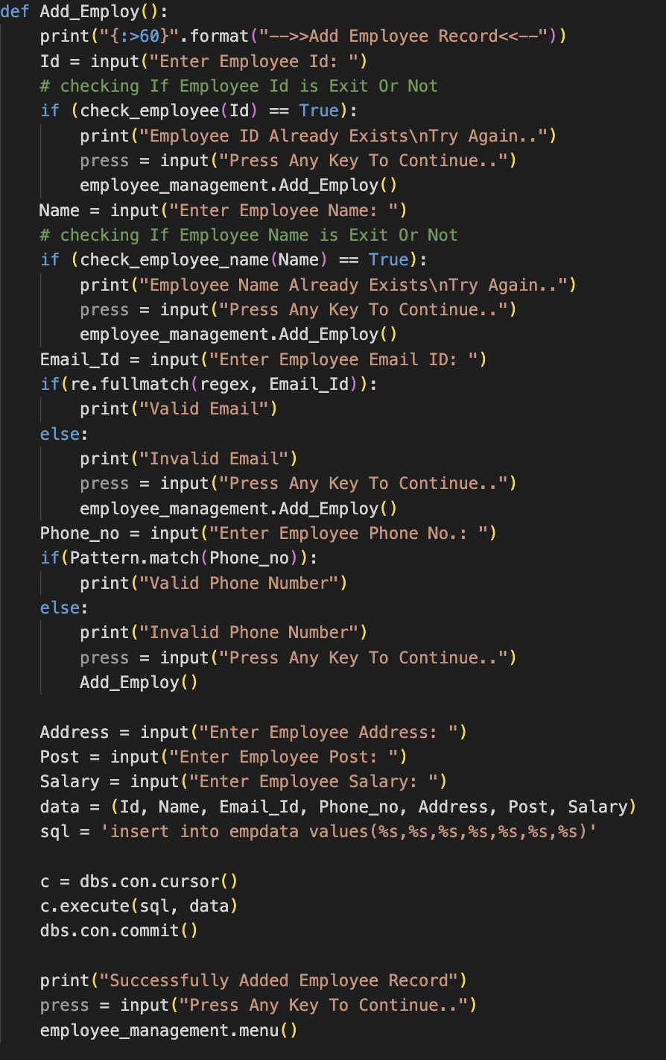
ADD EMPLOYEE

Slide 11
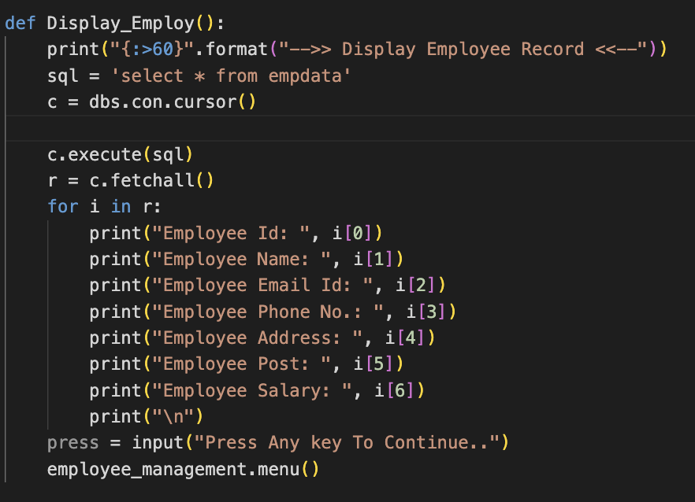
VIEW EMPLOYEES

Slide 12
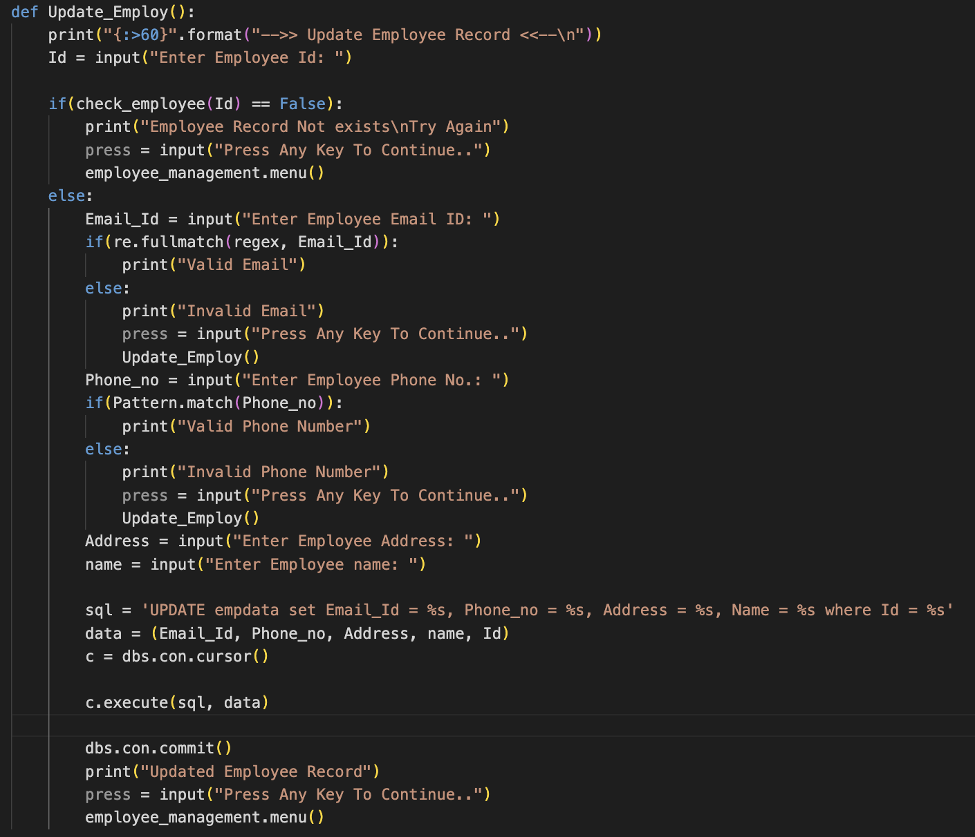
UPDATE EMPLOYEE DETAILS

Slide 13
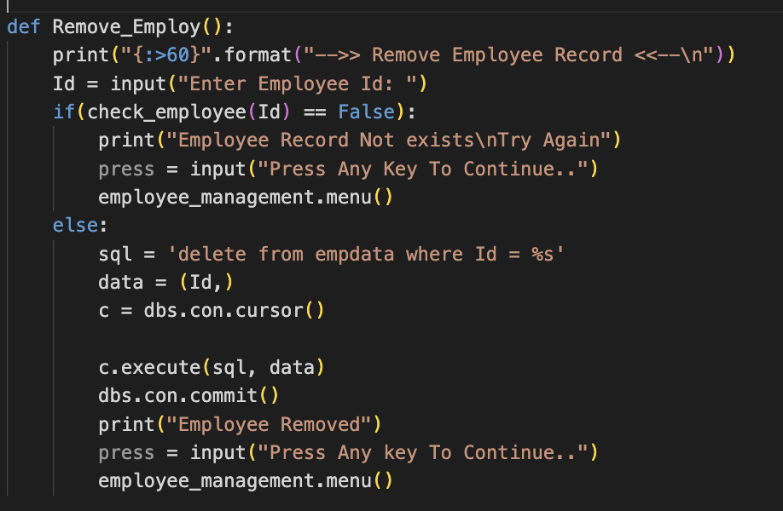
DELETE EMPLOYEE

Slide 14
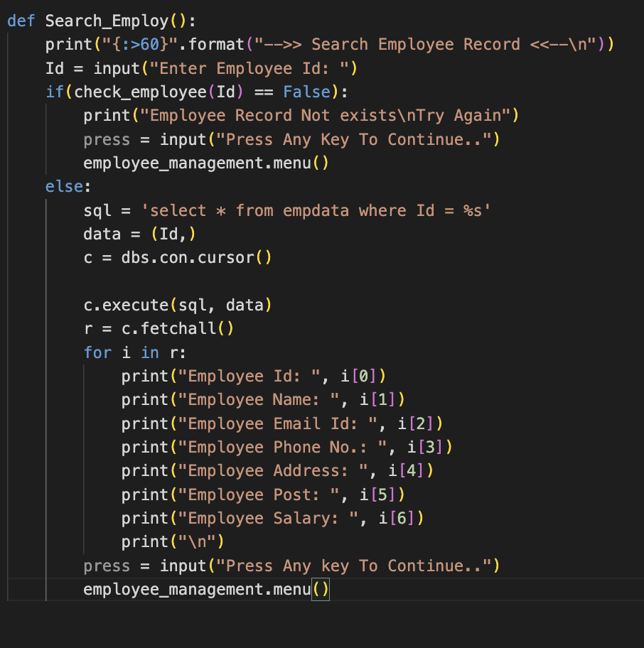
SEARCH EMPLOYEE

Slide 15
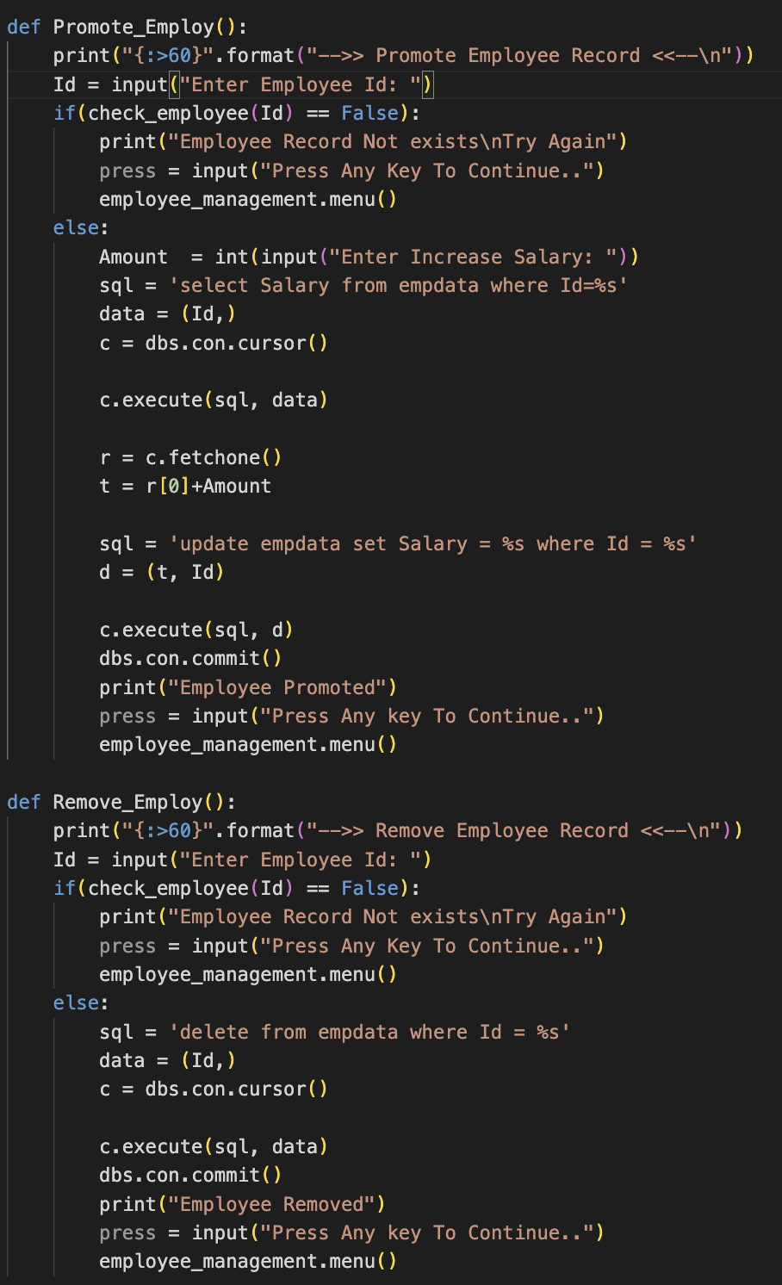
PROMOTE EMPLOYEE

Slide 16
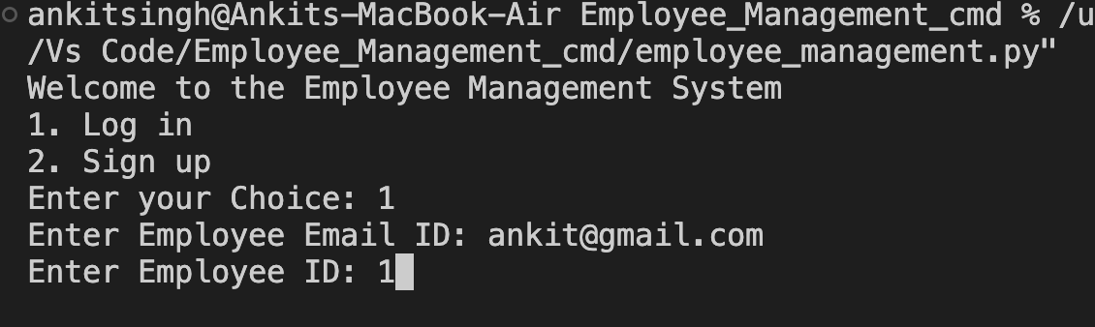
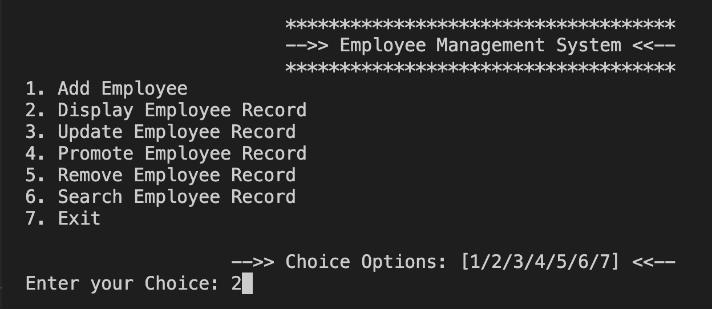
OUTPUTS

Slide 17
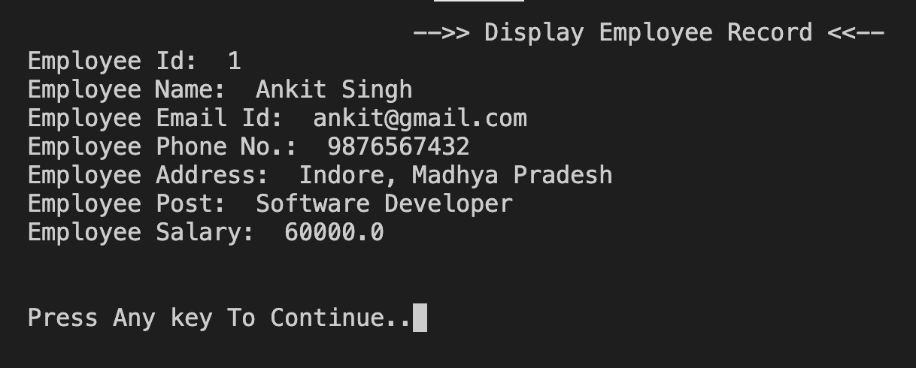
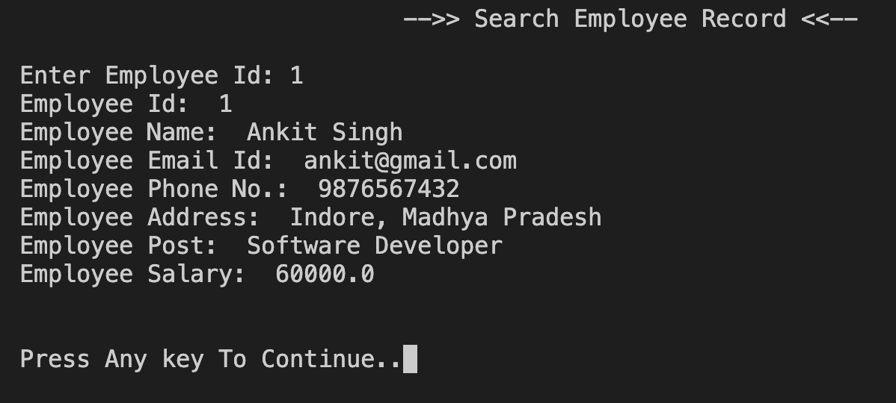
OUTPUTS

Slide 18
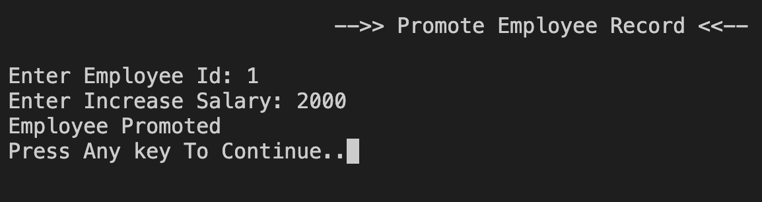
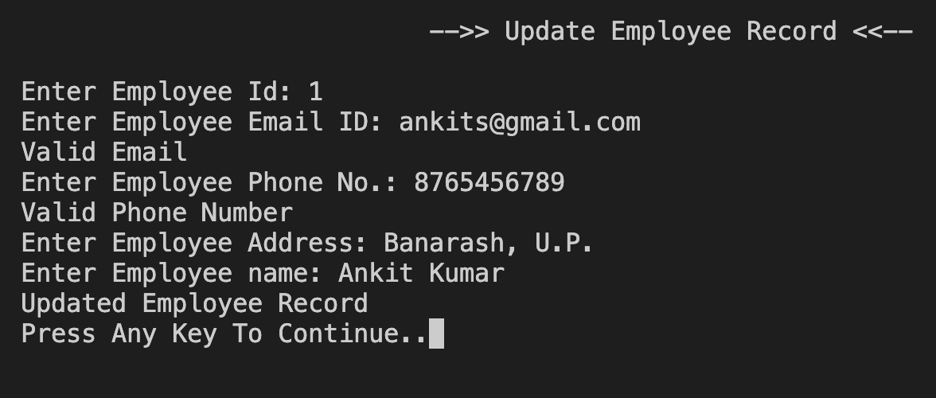
OUTPUTS

Slide 19
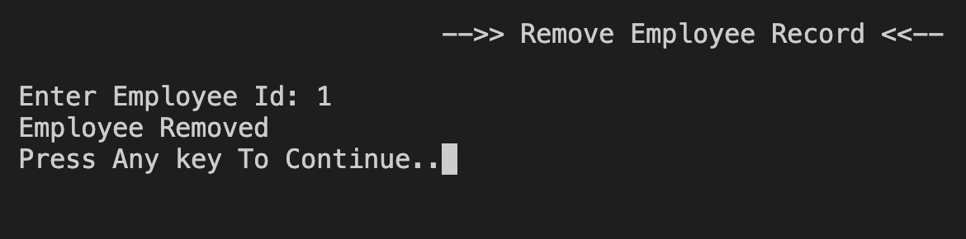
OUTPUTS

Slide 20
CONCLUSION
The Employee Management System is a basic console-based application that helps manage employee data using Python and MySQL.

Slide 21
THANK YOU

